Slide 1
Sources of Energy
CHAPTER 14
Part 5- How Long will the Energy Last
Notes:
Lets start with our Chapter 1- that is Chemical Reactions and Equations

Slide 2
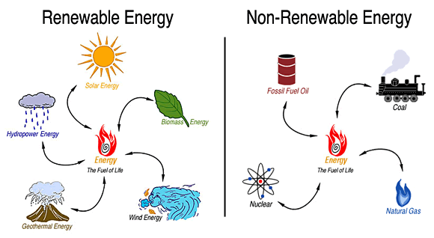
How Long will the Energy Last
Renewable energy resources
The solar energy, tidal energy, wind energy, hydroelectric energy, geothermal energy, etc. will never get exhausted as they can be generated at the same rate at which they are being used.
Non-renewable energy source, they are limited in quantity.
Notes:
We can split our discussion in two directions. We first talk about how long a renewable energy source will last us. Renewable energy resources are called ‘renewable’ because they are constantly renewed or regenerated.
The energy from the sun, the movement of the waves, the flow of the river – these are some of the activities that have been happening over millions of years and will continue to happen in the future. They are constant and reliable sources.
The solar energy, tidal energy, wind energy, hydroelectric energy, geothermal energy, etc. will never get exhausted as they can be generated at the same rate at which they are being used.
When we talk about the non-renewable energy source, they are limited in quantity. They cannot be renewed easily once they are depleted. They take thousands of years to be formed. At the present rate of consumption, these resources will get exhausted in less than a hundred years.
When we talk about the non-renewable energy source, they are limited in quantity. They cannot be renewed easily once they are depleted. They take thousands of years to be formed. At the present rate of consumption, these resources will get exhausted in less than a hundred years.

